Slide 1
Concentration polarization derivation –multicomponent systems
Laurianne Estrada, Molly Dougher
2.24.25

Slide 2
Derivation overview
1
Calculating interfacial concentration
2
Generalized flux equation

Slide 3
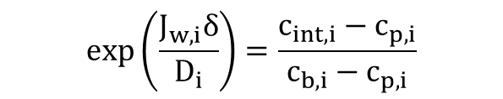
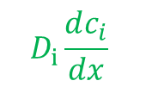







Concentration polarization derivation – single salt
1
Calculating interfacial concentration
Draw a control volume around the boundary layer and the membrane. Perform a mass balance.
Diffusive solute flux back into the bulk
$$J_{w}c_{i,p}=c_{i}J_{w}−D_{i}\frac{dc_{i}}{dx}$$
cv
$$D_{i}\frac{dc_{i}}{dx}$$
$${J_{s}=J}_{w}c_{i,p}$$
Solute flux through the membrane
Integrate over the boundary layer,
$$J_{w}c_{p,1}$$
$$δ$$
Convective flux of solute towards the membrane
$$\exp\left(\frac{J_{w,i}δ}{D_{i}}\right)=\frac{c_{int,i}−c_{p,i}}{c_{b,i}−c_{p,i}}$$
$$δ$$
Solve for $c_{int,i}$
$$c_{int,i}=c_{p,i}+\left(c_{b,i}−c_{p,i}\right)exp⁡(\frac{J_{w}δ}{D_{i}})$$

Slide 4
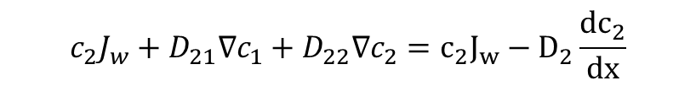

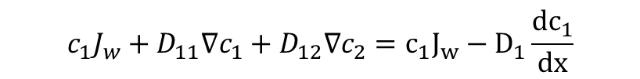



Concentration polarization derivation - multicomponent
The interfacial concentration for multicomponent systems can be solved by using the overall solute flux through the membrane equation previously derived.
$$c_{1}J_{w}+D_{11}∇c_{1}+D_{12}∇c_{2}=c_{1}J_{w}−D_{1}\frac{dc_{1}}{dx}$$
Diffusive solute flux back into the bulk
cv
$$D_{i}\frac{dc_{i}}{dx}$$
$${J_{s}=J}_{w}c_{i,p}$$
$$c_{2}J_{w}+D_{21}∇c_{1}+D_{22}∇c_{2}=c_{2}J_{w}−D_{2}\frac{dc_{2}}{dx}$$
Solute flux through the membrane
$$J_{w}c_{p,1}$$
Convective flux of solute towards the membrane
$$δ$$

Slide 5


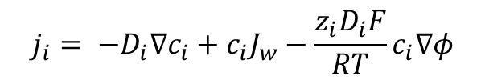
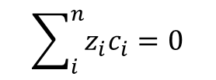
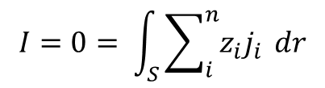
Generalizing the overall solute flux equation
2
Generalized flux equation
Overall solute flux equation
$$j_{i}= −D_{i}∇c_{i}+c_{i}J_{w}−\frac{z_{i}D_{i}F}{RT}c_{i}∇φ$$
Overall goal: to solve for the interfacial concentration of each ion in solution.
The MBDoE code currently incorporates concentration polarization for single salt systems only.
Advancing to multicomponent systems requires an interfacial concentration for each ion present to be calculated.
Ideally, the overall flux equation will be generalized to account for whether the experimental input is single salt or multicomponent.
Inputs known are salt identities: charge and solution diffusion coefficients.
Solve numerically.
Constraints
$$I=0= \int_{S}{\sum_{i}^{n}{z_{i}j_{i}} dr}$$
$$\sum_{i}^{n}{z_{i}c_{i}}=0$$

Slide 6

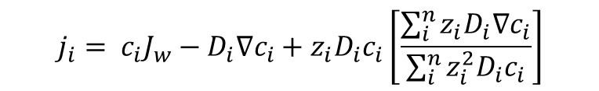

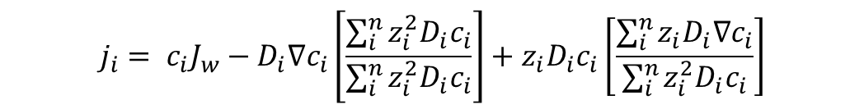
Generalizing the overall solute flux equation
Solve in a similar way as previously derived
$$j_{i}= c_{i}J_{w}−D_{i}∇c_{i}+z_{i}D_{i}c_{i}\left[\frac{\sum_{i}^{n}{z_{i}D_{i}∇c_{i}}}{\sum_{i}^{n}{z_{i}^{2}D_{i}c_{i}}}\right]$$
Can we simplify this equation further?
$$j_{i}= c_{i}J_{w}−D_{i}∇c_{i}\left[\frac{\sum_{i}^{n}{z_{i}^{2}D_{i}c_{i}}}{\sum_{i}^{n}{z_{i}^{2}D_{i}c_{i}}}\right]+z_{i}D_{i}c_{i}\left[\frac{\sum_{i}^{n}{z_{i}D_{i}∇c_{i}}}{\sum_{i}^{n}{z_{i}^{2}D_{i}c_{i}}}\right]$$
$$j_{i}= c_{i}J_{w}+\frac{z_{i}D_{i}c_{i}\left[\sum_{i}^{n}{z_{i}D_{i}∇c_{i}}\right]−D_{i}∇c_{i}\left[\sum_{i}^{n}{z_{i}^{2}D_{i}c_{i}}\right]}{\sum_{i}^{n}{z_{i}^{2}D_{i}c_{i}}}$$
Continue working on the multicomponent concentration polarization derivation.
Continue analyzing single salt NaCl, CaCl2, LaCl3 experiments with MBDoE. Implement solute flux with all three terms.

Slide 7


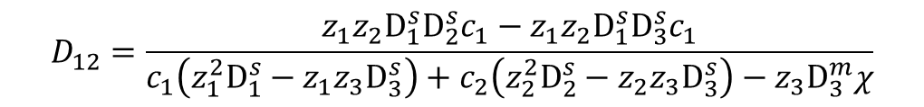
Overall flux equations
$$j_{1}= c_{1}J_{w}+D_{11}∇c_{1}+D_{12}∇c_{2}$$
$$D_{11}=\frac{z_{1}z_{3}D_{1}^{s}D_{3}^{s}c_{1}−z_{2}^{2}D_{1}^{s}D_{2}^{s}c_{2}+z_{2}z_{3}D_{1}^{s}D_{3}^{s}c_{2}+z_{3}D_{1}^{m}D_{3}^{m}χ−z_{1}^{3}D_{1}^{s}D_{3}^{s}c_{1}}{c_{1}\left(z_{1}^{2}D_{1}^{s}−z_{1}z_{3}D_{3}^{s}\right)+c_{2}\left(z_{2}^{2}D_{2}^{s}−z_{2}z_{3}D_{3}^{s}\right)−z_{3}D_{3}^{m}χ}$$
$$D_{12}=\frac{z_{1}z_{2}D_{1}^{s}D_{2}^{s}c_{1}−z_{1}z_{2}D_{1}^{s}D_{3}^{s}c_{1}}{c_{1}\left(z_{1}^{2}D_{1}^{s}−z_{1}z_{3}D_{3}^{s}\right)+c_{2}\left(z_{2}^{2}D_{2}^{s}−z_{2}z_{3}D_{3}^{s}\right)−z_{3}D_{3}^{m}χ}$$
$$j_{2}=c_{2}J_{w}+{\text{D}}_{\text{2}\text{1}}∇c_{1}+{\text{D}}_{\text{2}\text{2}}∇c_{2}$$
$${\text{D}}_{\text{2}\text{1}}=\frac{c_{2}\left(z_{1}z_{2}D_{1}^{s}D_{2}^{s}−z_{1}z_{2}D_{2}^{s}D_{3}^{s}\right)}{c_{1}\left(z_{1}^{2}D_{1}^{s}−z_{1}z_{3}D_{3}^{s}\right)+c_{2}\left(z_{2}^{2}D_{2}^{s}−z_{2}z_{3}D_{3}^{s}\right)}$$
${\text{D}}_{\text{22}}=\frac{c_{1}\left(z_{1}z_{3}D_{2}^{s}D_{3}^{s}{−z}_{1}^{2}{D_{1}^{s}D_{2}^{s}}_{1}\right)+c_{2}\left(z_{2}z_{3}D_{2}^{s}D_{3}^{s}−z_{2}^{2}D_{2}^{s}D_{3}^{s}\right)}{c_{1}\left(z_{1}^{2}D_{1}^{s}−z_{1}z_{3}D_{3}^{s}\right)+c_{2}\left(z_{2}^{2}D_{2}^{s}−z_{2}z_{3}D_{3}^{s}\right)}$

